Slide 1
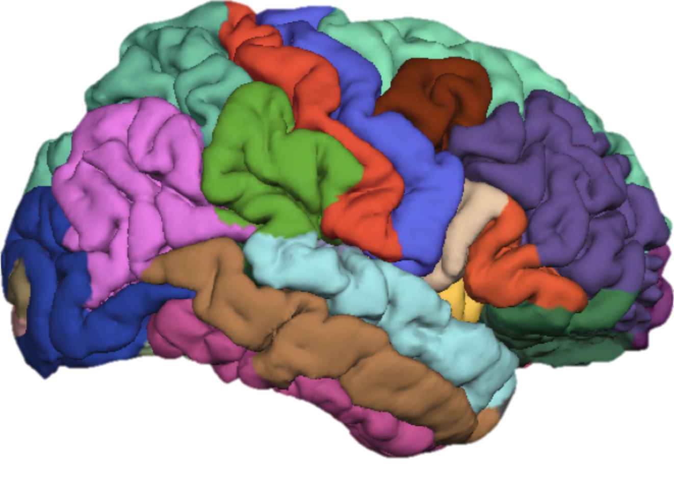
FreeSurfer Class 5: Other Cool FreeSurfer Uses
Cat Camacho
2/27/17
11:00am-12:30pm

Slide 2
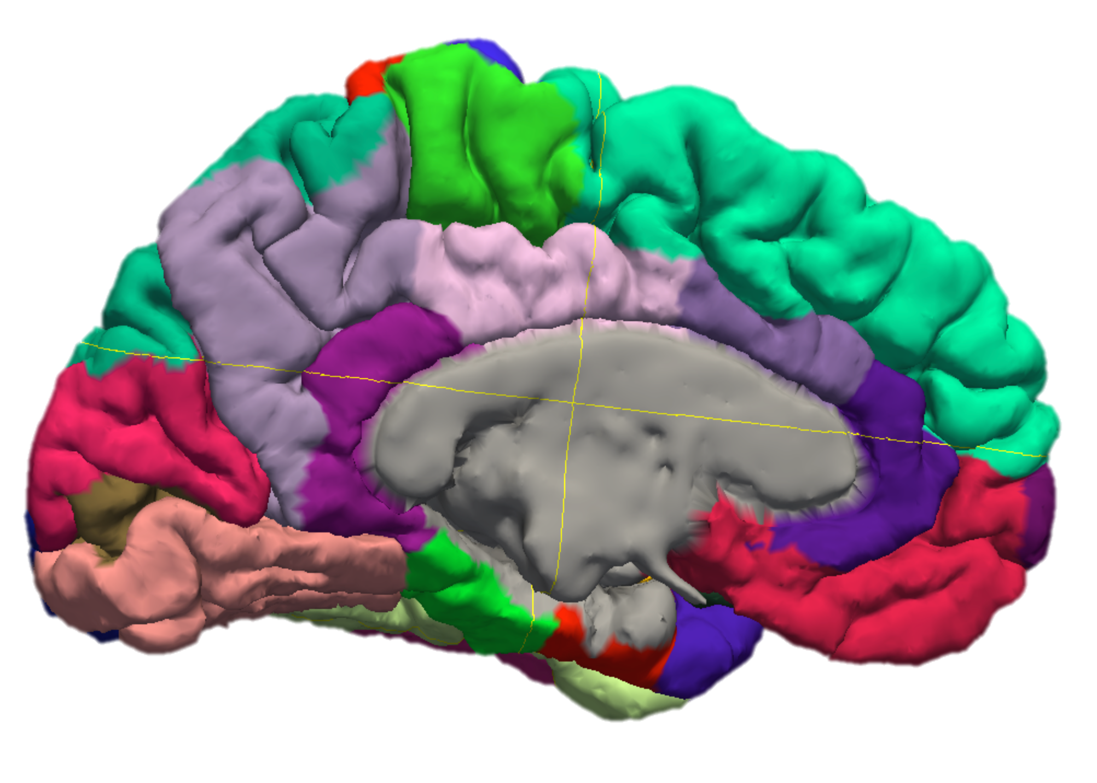
Goals for Today
Check in about recon-all
Any questions?
Multimodal Data
Using T2w images
Hippocampal subfields
TRACULA
Diffusion processing
Tractography
Other stuff worth mentioning

Slide 3
FreeSurfer 6.0 is out!
Recon-all changes/additions:
Hippocampal subfields
Brainstem subfields
Aseg improvements
Improved segmentation of data <1mm cubic voxel (-highres flag)
Parallelization (-parallel flag)
can run recon-all in 3 hours!
by default uses 4 cores, but can be adjusted (-openmp <numberofcores>)
Other new things:
PETSurfer
Introduces partial volume correction and kinetic modeling
Cognitive Ontology brain maps: http://people.csail.mit.edu/ythomas/publications/2015BrainmapInteractive/index.html

Slide 4
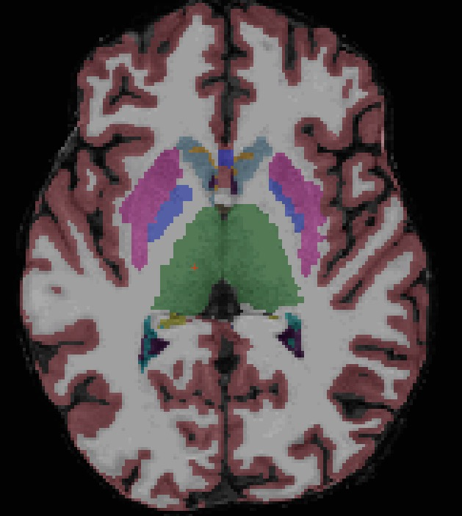
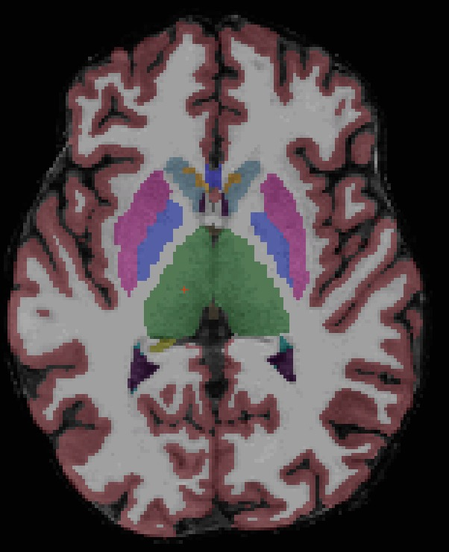
The Difference is Real
FreeSurfer 5.3
FreeSurfer 6.0
The putamen doesn’t overextend laterally as much
Surfaces make improvements to cortex aseg automatically now

Slide 5
Multimodal Data
FreeSurfer has optional inputs that can improve pial estimation and hippocampal/brainstem segmentation:
To add a T2w anat, use the -T2pial flag accompanied with -T2 <t2w data filepath>
To add a FLAIR volume, use the -FLAIRpial flag accompanied with -FLAIR <FLAIR filepath>
>> recon-all -s Meghan -T2 /home/catcam1/FS_Class/raw/Meghan/Meghan_T2w_1.nii.gz -T2pial -autorecon2 -autorecon3
>> recon-all -s Meghan -FLAIR /home/catcam1/FS_Class/raw/Meghan/Meghan_FLAIR_1.nii.gz
-FLAIRpial -autorecon2 -autorecon3
Note: the sample data doesn’t include a FLAIR scan.

Slide 6
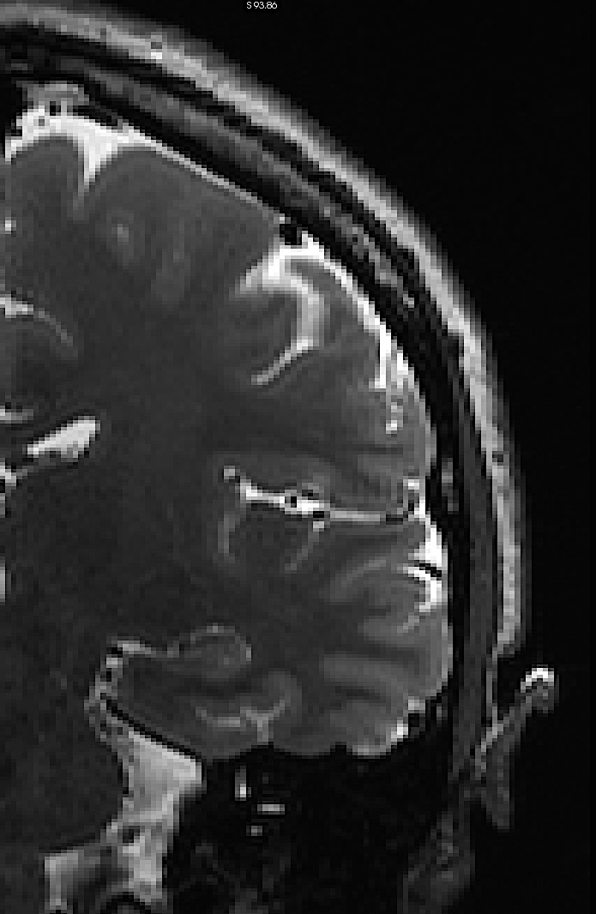
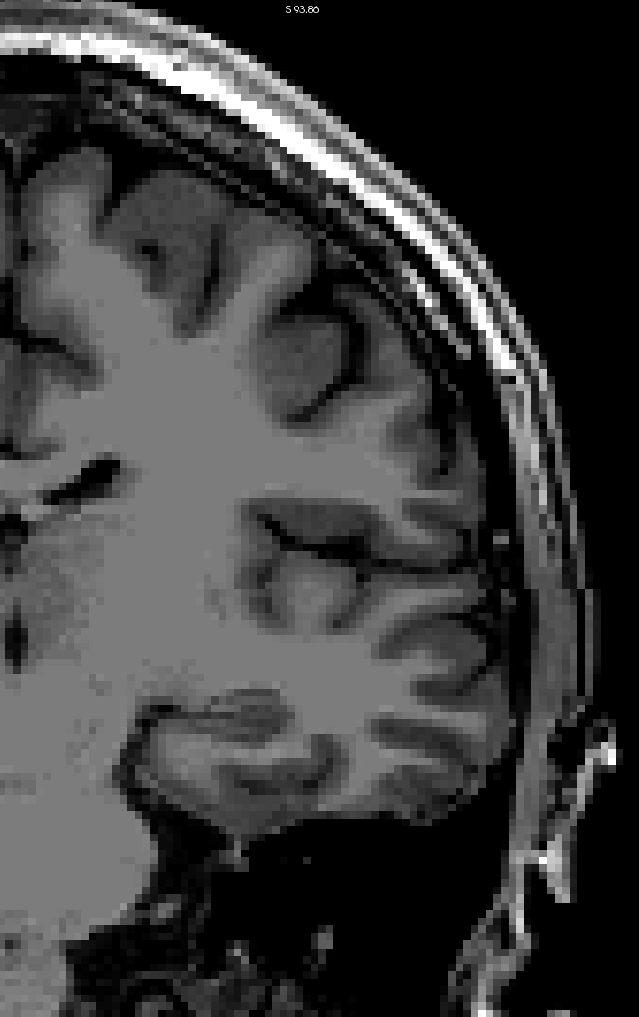
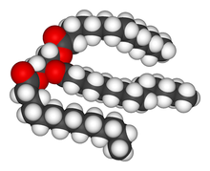
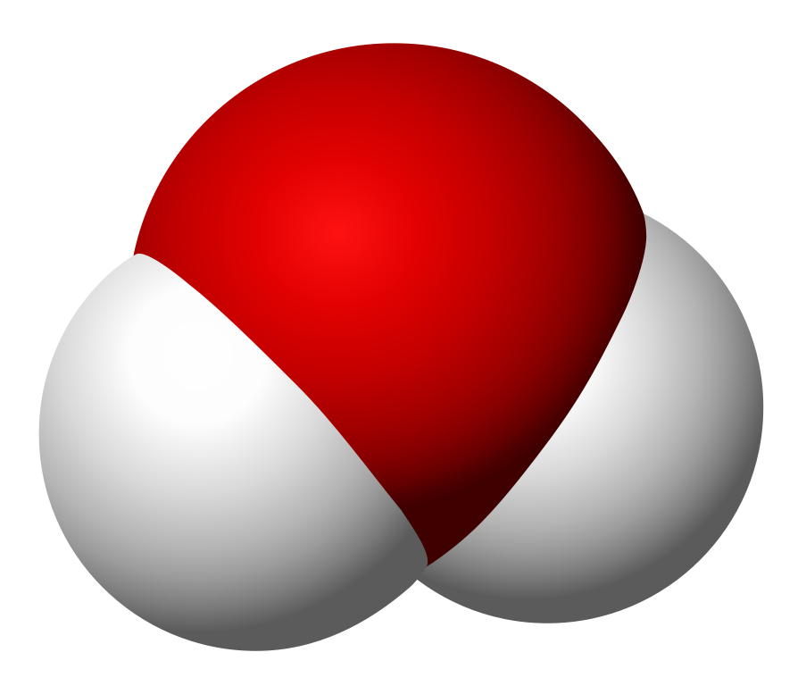
T2w Imaging
T2w
T1w
Watery tissue
Increasing proton density
(or decreasing water content)
Fatty tissue

Slide 7
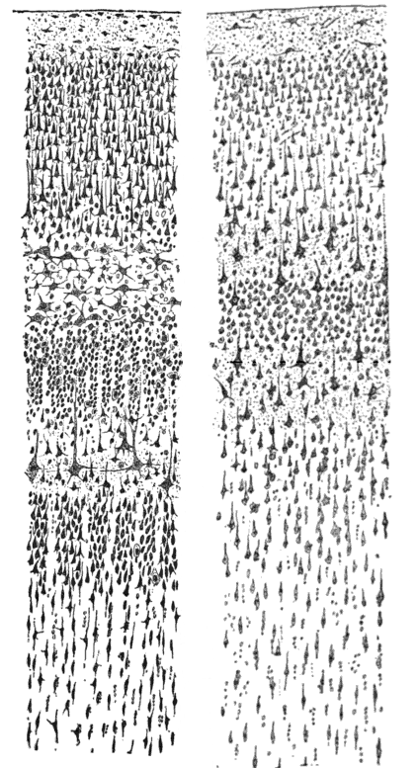
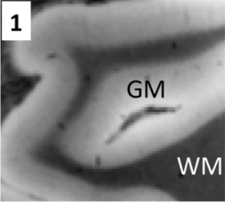
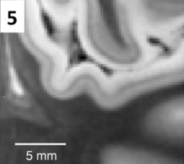
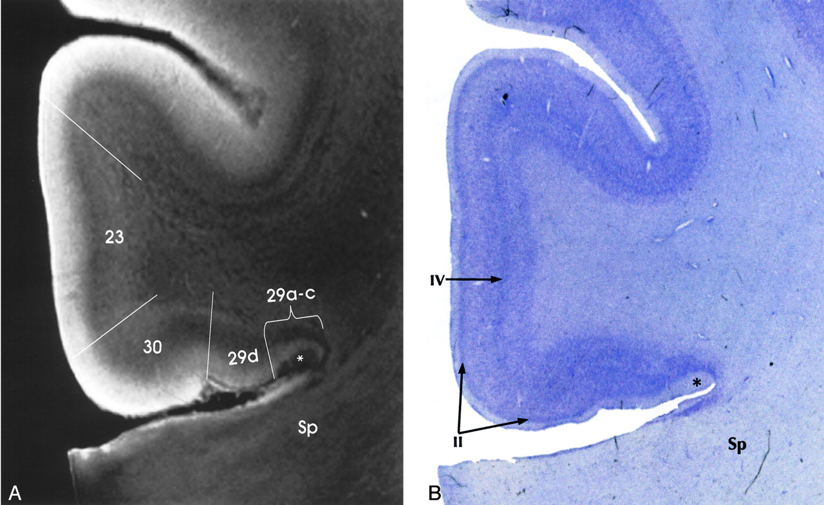
The Cortex
High resolution T2w imaging can provide better imaging of the nuanced cortical layers.
For Freesurfer, this means better pial surface estimations and better hippocampal subfield estimation.
Schafee et al. 2015

Slide 8
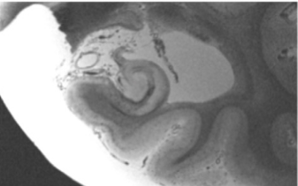
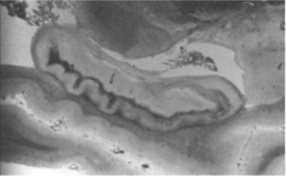
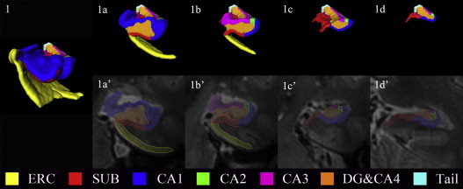
Why Segment the Hippocampus?
The hippocampus is a well connected limbic structure with histologically distinct regional composition. Recently, these subfields can be captured in vivo using high resolution T2w MRI.
Relevance to Depression
Smaller CA1 and subiculum volumes are associated with severity and chronicity in adults (Bearden 2009)
Smaller subiculum volumes is associated with chronicity in late life MDD (Wisse 2015)
Smaller Dentate Gyrus/CA4, CA2/CA3, and CA1 associated with chronic MDD in adults (Treadway 2015)
Relevance to Stress
Smaller CA3 and dentate gyrus in adults with PTSD (Wang 2010)
CA3 has large concentration of glucocorticoid receptors. The DG is one of the few sites of neurogenesis in the brain.
Inglesias 2015
Wisse 2015

Slide 9
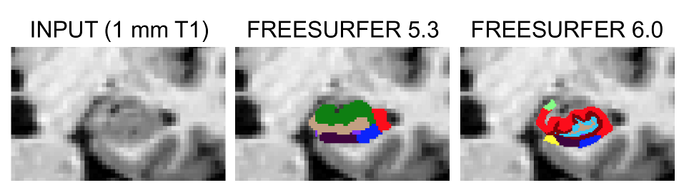
5.3 versus 6.0 comparison
5.3 Regions
6.0 Regions
CA2 and CA3
Alveus
CA1
Fimbria
Presubiculum
Hippocampal Fissure
CA4 and Dentate Gyrus
Subiculum
Hippocampal Tail
Alveus
Parasubiculum
Presubiculum
Subiculum
CA1
CA2 and CA3
CA4
Granular Cell-Dentate Gyrus
HATA (hipp-amyg transition)
Fimbria
Molecular Layer
Hippocampal Fissure
Hippocampal Tail
Leemput K Van, Bakkour A, Benner T, et al. Automated Segmentation of Hippocampal Subfields From Ultra-High Resolution In Vivo MRI. doi:10.1002/hipo.20615.
Iglesias JE, Augustinack JC, Nguyen K, et al. A computational atlas of the hippocampal formation using ex vivo, ultra-high resolution MRI: Application to adaptive segmentation of in vivo MRI. Neuroimage. 2015;115:117-137. doi:10.1016/j.neuroimage.2015.04.042.
Notes:
Validated in Alzheimer’s patients

Slide 10
Hippocampal Segmentation
To run segmentation on an existing subject with an additional T2w scan (recommended):
Or, to use only the existing T1w scan:
Note: You will need to install a matlab runtime tool before performing subfield segmentation. That link can be found for free (no license required) here: https://surfer.nmr.mgh.harvard.edu/fswiki/MatlabRuntime
>> recon-all -s Meghan -hippocampal-subfields-T1T2 /home/catcam1/FS_Class/raw/Meghan/Meghan_T2w_1.nii.gz t1t2
>> recon-all -s Meghan -hippocampal-subfields-T1

Slide 11
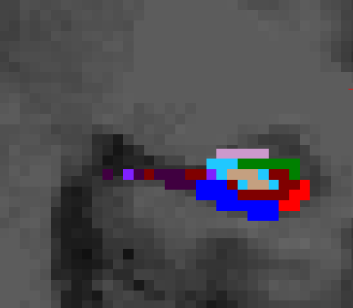
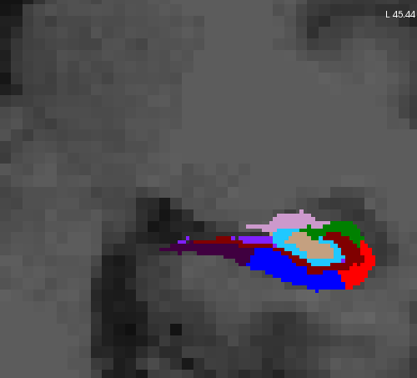
QCing the hippocampus
Open the following in FreeView:
Volumes
mri/t1t2.FSspace.mgz (if T2w is used)
mri/T1.mgz
Segmentation
mri/*h.hippoSfLabels-T1-t1t2.v10.mgz
This segmentation is in 0.333mm³ voxel space.
mri/*h.hippoSfLabels-T1-t1t2.v10.FSvoxelSpace.mgz
This segmentation is in 1mm³ voxel space.
Remember, if you can’t see the boundaries, neither can FreeSurfer!

Slide 12
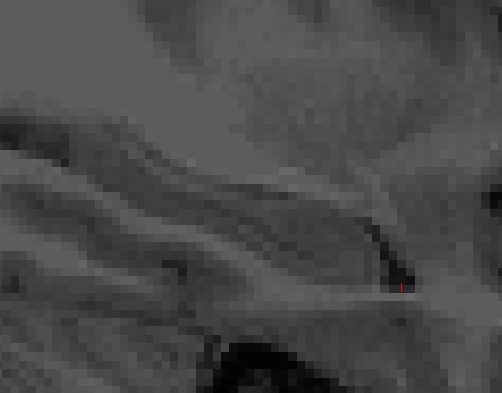
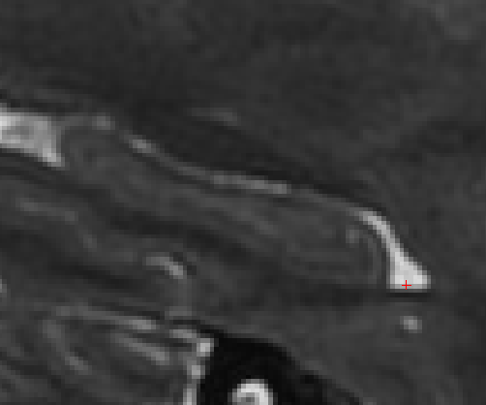
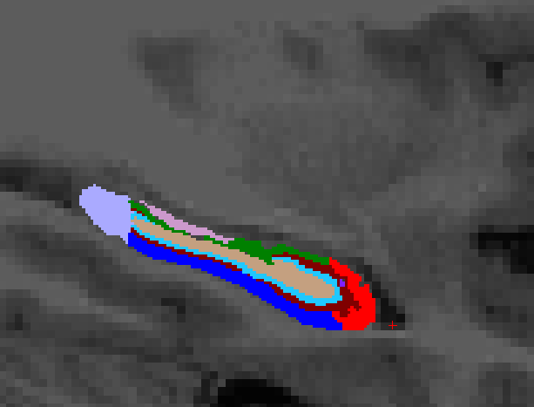
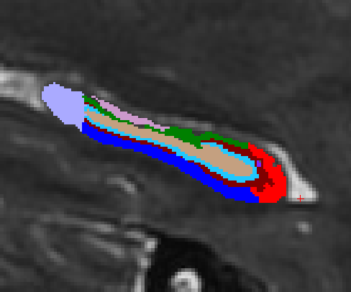

Slide 13
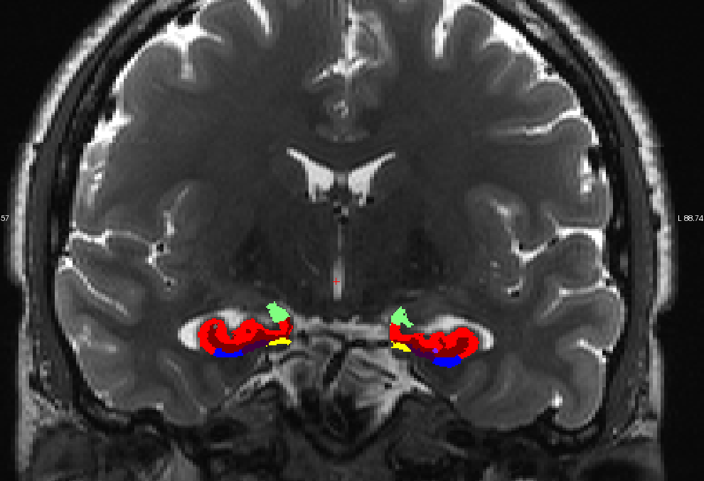
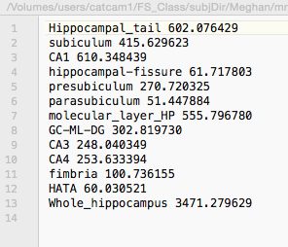
Extracting Data
Hippocampus subfield data is not stored in the same place as the other stats (idk why)
Within each subject’s mri folder are 2 text files from which volumetric data can be extracted:
*h.hippoSfVolumes-T1-t1t2.v10.txt

Slide 14
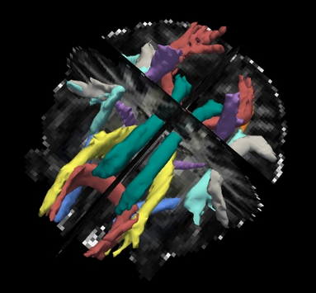
TRACULA
TRActs Constrained by UnderLying Anatomy

Slide 15
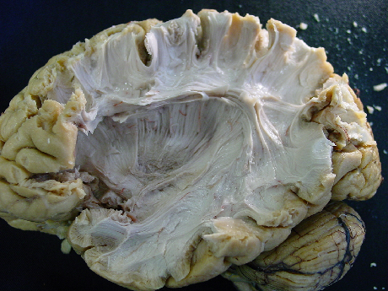
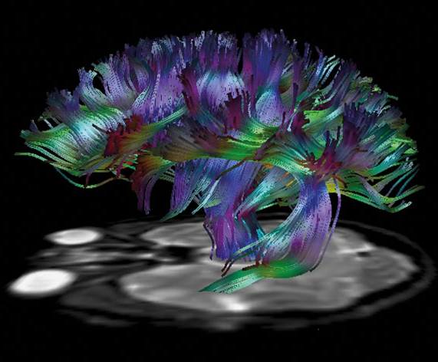
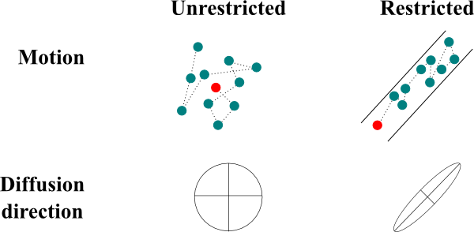
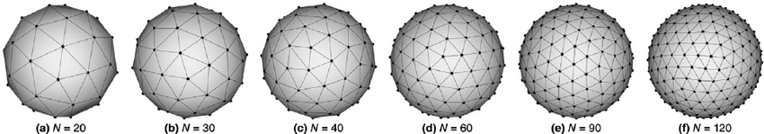
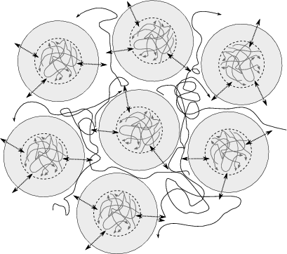
Brief Notes on Diffusion
Diffusion weighting imaging takes advantage of Brownian [random] motion in water.
If unrestricted [by surrounding tissue] water moves in a random direction.
If restricted [by surrounding tissue] water follows the path of least resistance.
With this knowledge, we can infer tissue properties, including physical connectivity between brain regions, by measure the water in many directions and fitting paths from the resulting information.

Slide 16
TRACULA
Fully automated diffusion processing and probabilistic tractography
Pros
Easily implemented in large datasets without manual
Incorporates recon-all outputs to improve preprocessing and provide subject-specific anatomical ROIs
Uses atlases to infer spatial estimates (sound familiar?)
Produces whole tract and voxel-wise tract information
Cons
Processing time (really needs to be run on a cluster)
can take 12-24 hours on a single core per subject
Depending on your personal preferences, there are many more
Made on adults
Dependent on good FS outputs
TRACULA Landing page:
https://surfer.nmr.mgh.harvard.edu/fswiki/Tracula

Slide 17
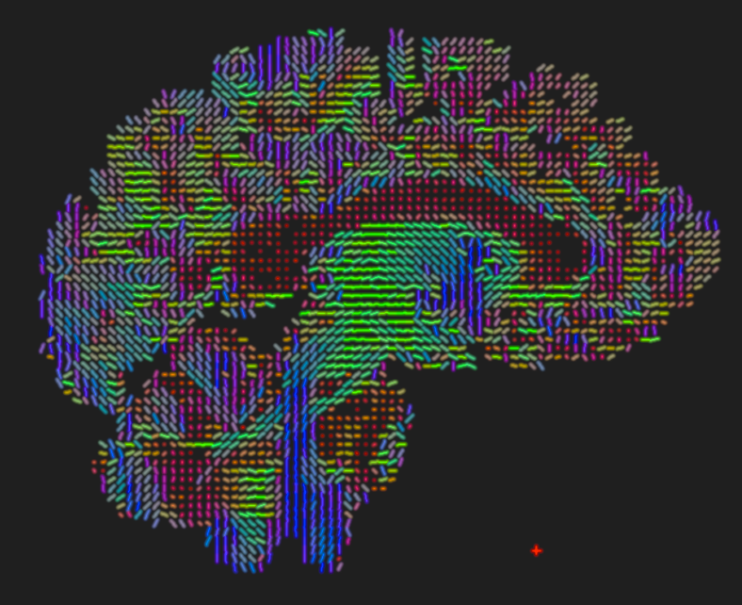
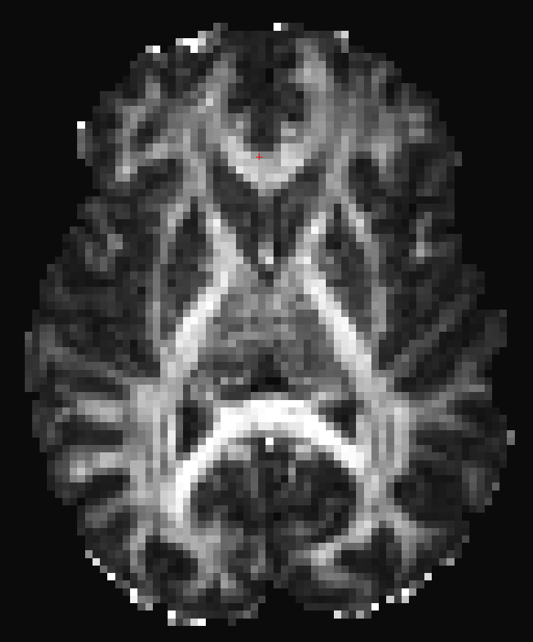
Tracts included
Corticospinal tract (CST)
Inferior longitudinal fasciculus (ILF)
Uncinate fasciculous (UF)
Anterior thalamic radiation (ATR)
Cingulum- cingulate gyrus (supracallosal) bundle (CCG)
Cingulum- angular (infracallosal) bundle (CAB)
Superior longitudinal fasciculous-parietal bundle (SLFP)
Superior longitudinal fasciculous-temporal bundle (SLFT)
Corpus callosum- forceps major (FMAJ)
Corpus callosum- forceps minor (FMIN)
Yendiki A, Panneck P, Srinivasan P, et al. Automated probabilistic reconstruction of white-matter pathways in health and disease using an atlas of the underlying anatomy. Front Neuroinform. 2011;5:23. doi:10.3389/fninf.2011.00023.

Slide 18
Processing Flow
1. Preprocessing
2. Bedpost
3. Tract construction

Slide 19
Preprocessing Steps (~1-2 hours)
1. Image Correction
2. Registration
3. Tensor Fitting

Slide 20
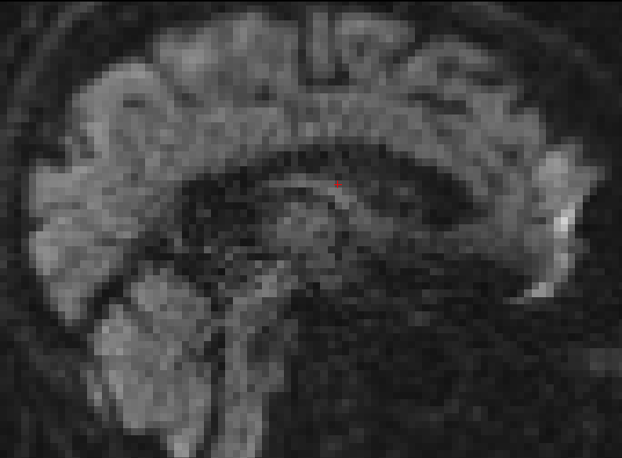
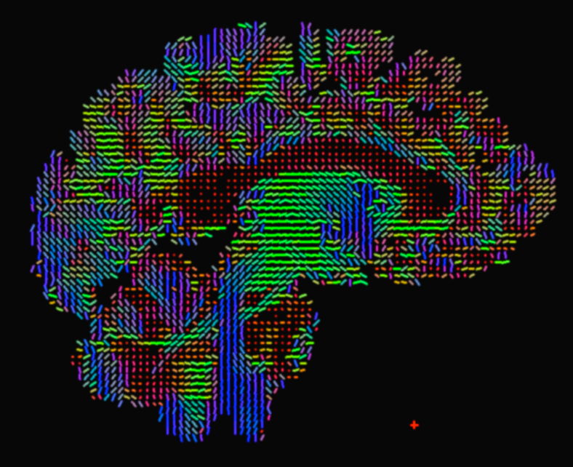
Preprocessing Steps
Eddy-current compensation
Computing measures of head motion during the DWI scan (see Yendiki 2013)
Intra-subject registration (individual DWI to individual T1)
Inter-subject registration (individual T1 to a common template space)
Creation of cortical and white-matter masks from FreeSurfer reconstructions
Tensor fitting for extraction of tensor-based measures (FA, MD, etc)
Computing anatomical priors for white-matter pathways from the TRACULA atlas

Slide 21
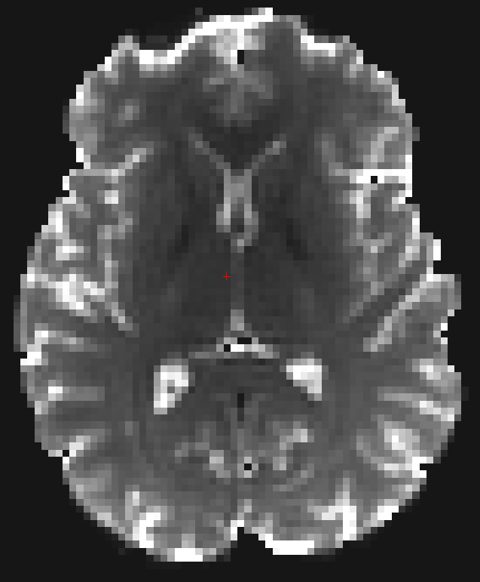
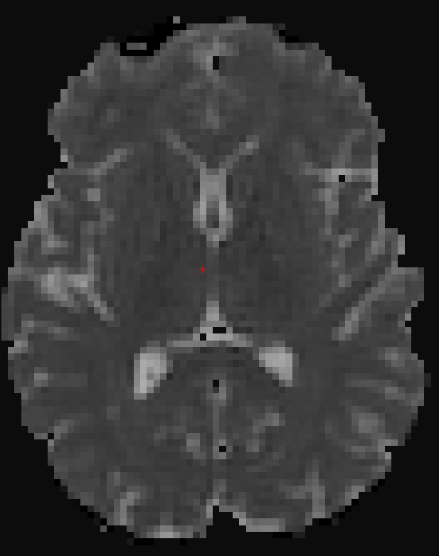
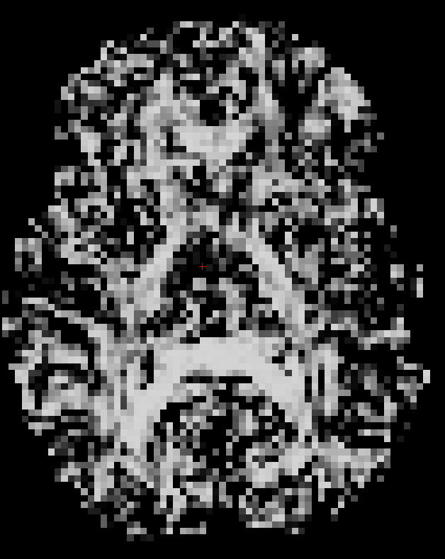
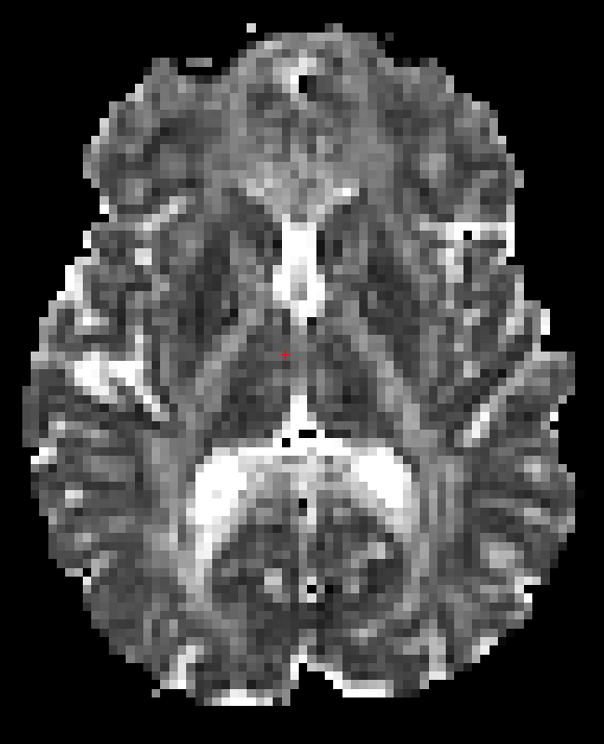
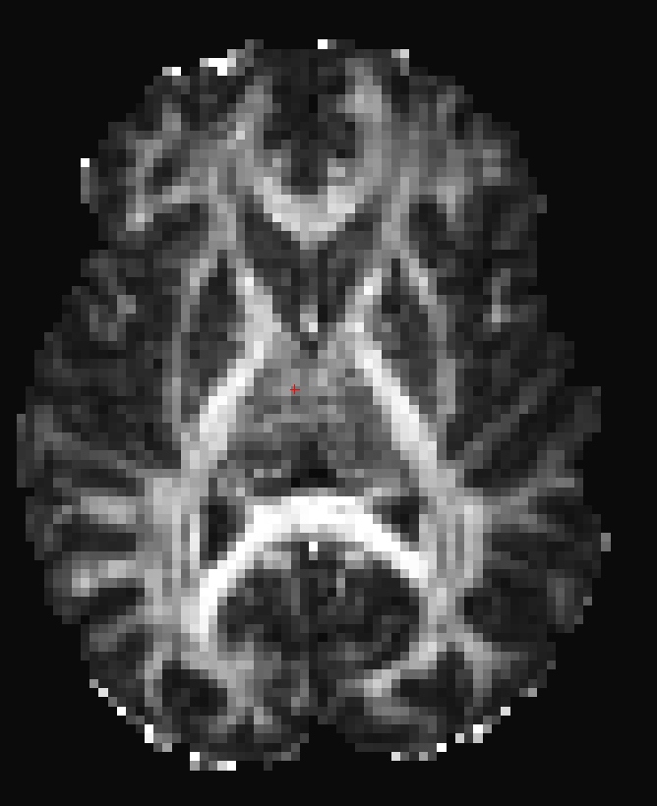
Preprocessing Outputs
Found in Subject Folder/dmri:
Tensor-fitting outputs:
dtifit_V1 - 1st eigenvector
dtifit_V2 - 2nd eigenvector
dtifit_V3 - 3rd eigenvector
dtifit_L1 - 1st eigenvalue
dtifit_L2 - 2nd eigenvalue
dtifit_L3 - 3rd eigenvalue
Preprocessing general outputs:
dtifit_MD - mean diffusivity
dtifit_FA - fractional anisotropy
dtifit_MO - mode of the anisotropy
dtifit_S0 - raw T2 signal with no diffusion weighting
Motion outputs:
dwi_motion.txt
dwi_snr.txt

Slide 22
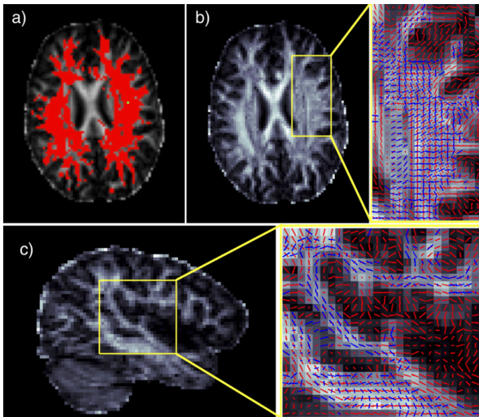
Ball and Stick Model Fitting BEDPOSTX (8-15 hours)
Outputs are in dmri.bedpostX
BEDPOSTX stands for Bayesian Estimation of Diffusion Parameters Obtained using Sampling Techniques
This technique allows modeling of crossing fibers within each voxel by running Markov Chain Monte Carlo sampling to build up distributions of diffusion parameters at each voxel.
Behrens TEJ, Berg HJ, Jbabdi S, Rushworth MFS, Woolrich MW. Probabilistic diffusion tractography with multiple fibre orientations: What can we gain? Neuroimage. 2007;34(1):144-155. doi:10.1016/j.neuroimage.2006.09.018.

Slide 23
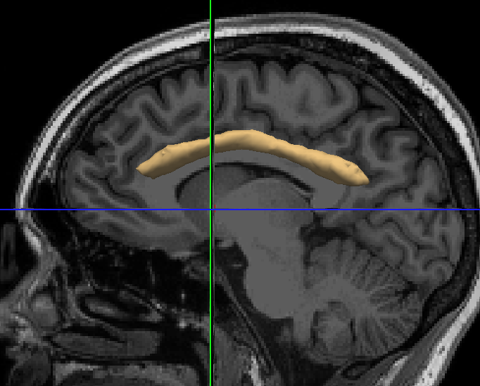
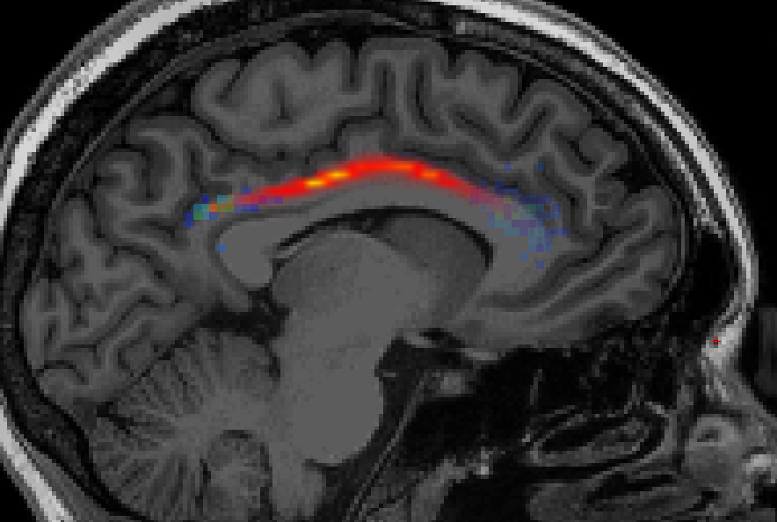
Pathway (tract) Reconstruction
TRACULA takes the two endpoints designating one and the “source” and the other as the “target”.
Next, using the control points set by reconciling the atlas with the underlying anatomy, it probabilistically constructs the tracts.
Final tracts (saved for each hemisphere) are found in the dpath folder can be viewed in freeview

Slide 24
Running TRACULA
Create a config file (example in class repo)
Run preprocessing:
Run bedpost:
Run pathway reconstruction:
Extract stats:
>> trac-all -c /path/to/tracula_config.txt -prep
>> trac-all -c /path/to/tracula_config.txt -bedp
>> trac-all -c /path/to/tracula_config.txt -path
>> trac-all -c /path/to/tracula_config.txt -stat

Slide 25
Other FreeSurfer things worth mentioning
FreeSurfer outputs are well integrated into other processing programs and languages:
CONN
AFQ
NiPype
FSL
GAT
And many more!
There are functionally-derived atlases for the both the cerebellum and the rest of the brain (see Yeo 2012)
You can segment the brainstem just like the hippocampus: https://surfer.nmr.mgh.harvard.edu/fswiki/BrainstemSubstructures
You can make your own atlases, too! https://surfer.nmr.mgh.harvard.edu/fswiki/SurfaceLabelAtlas

Slide 26
Other FreeSurfer things worth mentioning
There is a longitudinal pipeline built in for the whole brain parcellation and the hippocampus: https://surfer.nmr.mgh.harvard.edu/fswiki/LongitudinalProcessing
Note: Not meant for developmental studies (assumes constant head size)
With FreeSurfer 6.0, there is now PETSurfer for your PET-MR needs!
This introduces a partial volumes correction algorithm that can be applied to MRI (see Schafee 2015 for a really cool implementation)
FreeSurfer comes with a surface analysis program built in called QDEC: http://freesurfer.net/fswiki/FsTutorial/QdecGroupAnalysis_freeview

Slide 27
Thank You ☺

